Slide 1

Mapping Inputs to Outputs: Evaluate Output
Professor Bo Liu
James Watt School of Engineering

Slide 2

Prediction error evaluation
Represent data: the data should be translated to the language that ML algorithms can understand → Data types/encoding
Select ML algorithms: Using parametric or non-parametric ML?
Evaluate output: prediction errors
Prediction
Apple
Not Apple
Prediction error evaluation
Input
Trained model
Output

Slide 3
Prediction and prediction error
Task of prediction: prediction means to predict the outcomes of new input data.
The performance of a predictor is measured by the prediction error.
Prediction error: the difference between the predicted values made by some model and the actual values.

Slide 4
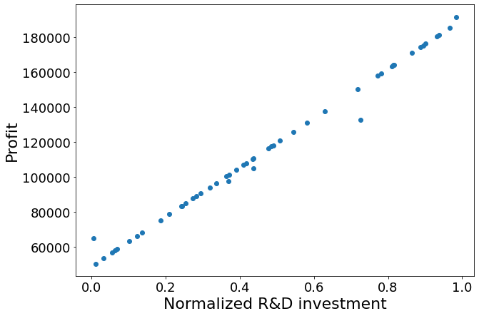

Prediction and prediction error
Prediction error: the difference between the predicted values made by some model and the actual values.
predicted value
$$y=\text{4985} \text{x}\text{ +13911}$$
Prediction error
actual value

Slide 5




Thanks!
#UofGWorldChangers
@UofGlasgow

